Slide 1
Space Time Card
System Level Design Phase
Eva Czukkermann, Ian Dolfi, Nsadhu Muyinda, Drew Schacke, Luke Schrom, Tanner Smith

Slide 2
Overview
Feedback from Last Review
Team Vision
Problem Statement Redefined
Functional Decomposition
Functional Benchmarking
Concept Development
Morphological Chart/System Concept Generation
Updated Project Overview
Feasibility
Concept Evaluation & Selection
System Architecture
Risk Assessment
Solution Statement
Open Items
Goals for Next Phase
Notes:
Tanner

Slide 3
Feedback from Last Review
Constraints
Size, weight, and power characteristics are compatible with 12U CubeSat or smaller
Timekeeping drift less than 30 nanoseconds per earth day
Include an FPGA for custom programmable logic synthesis
Integrated Atomic Clock for timekeeping
Completely Open-Source
Maximum budget constrained to $10k, preference placed on under $5k
Notes:
Eva

Slide 4
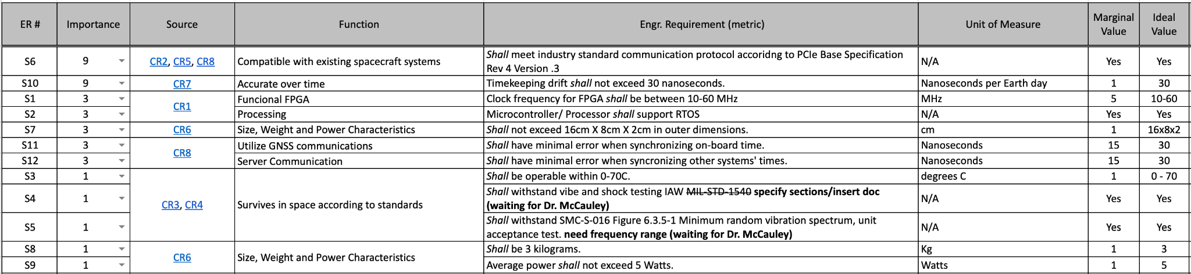
Engineering Requirements
Customer/Engineering Requirements Spreadsheet
Notes:
Eva

Slide 5
Team Vision for System Level Design Phase
As a team, our main goal for the system level design phase was to identify the key functions of the time card. Through the use of functional decomposition we were able to parse through functionalities that are required and generate initial concepts in order to achieve identified functions.
Overall, the functional decomposition allowed us to identify required functions and risks, as well as shorten the list for required standards and documentation. This allowed for a greater understanding as a team how we are going to solve the outstanding issues and whether our goals are feasible.
Notes:
Tanner

Slide 6
Problem Statement Redefined
The current ready-to-use space-qualified precision timekeeping devices available cost hundreds to millions of dollars.
The goal of this project is to design and build a derivative FPGA Time Card. The timekeeping drift must be less than 30 nanoseconds per Earth day. It must be compatible with CubeSats and its standards, compatible with existing spacecraft, and able to communicate with existing time networks.
This low-cost alternative must have comparable performance under $10k. Operational characteristics will be compliant with NASA LunaNet Standard, and its size, weight, and power characteristics will be compatible with a 12U CubeSat or smaller. There shall be minimal error when synchronizing on-board time and when synchronizing with other systems’ times. The atomic clock must survive deep space conditions for at least 10 years.
Notes:
Eva

Slide 7
Concept Development
Recognized 5 main functions to implement final design of the Space Time Card:
Method of Timekeeping
To create a time card rated for space, a high precision timekeeping device is crucial
Communication - Mechanical Connector
Provides communication from card to server - rugged to withstand expected vibrations
Communication - Protocol
Selecting and following a standard communication method allows future portability
Programmable Logic
Houses custom synthesized hardware to accomplish time analysis and correction
Processing System
Utilized to interface between the server and programmable logic
Notes:
Drew

Slide 8
Functional Benchmarking
Product Name | Holdover Drift | Sync Protocol | Interface | Size | GNSS compatibility | Temp Range | Max power consumption | Oscillator Type | Communication Protocol
Ours | <30 nsec / earth day | PPS / 10MHz | Single Lane or double* | 12U | GNSS Not Onboard | 0-70 C | 5W | OCXO | CAN (subject to change)
Safran ART time card | < 2us / earth day | PPS / 10MHz, PTP in future | PCIe 2.0 x 4 | 169.7mm x 86.4mm | GNSS L1/L2 or L1/L5 reception | -10°C to +60°C | Not Advertised | Rubidium (mR0-50) | USB-UART
OSA 5400 Timecard | ±100ns from UTC | PTP or PPS | PCIe | 111.15 mm x 14.47mm | GNSS L1/L2/L5 | 0°C to 70°C | Quartz HQ++: 10.5W (typical), 18.5W (max.) | OXCO or Rubidium | Proprietary
Open Timecard | Not advertised, just clock < 200ns drift | PPS | PCIe | Not Specified | GNSS L1/L2/L5 | Not specified | Not specified | Rubidium | Not Specified
Notes:
Tanner / Ian

Slide 9
Functional Decomposition
The main functions of the time card are:
Acquire and periodically adjust local clocks and minimize drift.
‘Hold-over’ functionality: Local systems can rely on provided clock/frequency signals.
Include various commonly used communication protocols for interfacing.
Possibly include GNSS support, either through external CubeSat means or onboard.
Time discrepancy detection including immediate adjustments and step corrections.
A function tree and transformation diagram were created to visualize the functional decomposition.
Notes:
Tanner

Slide 10
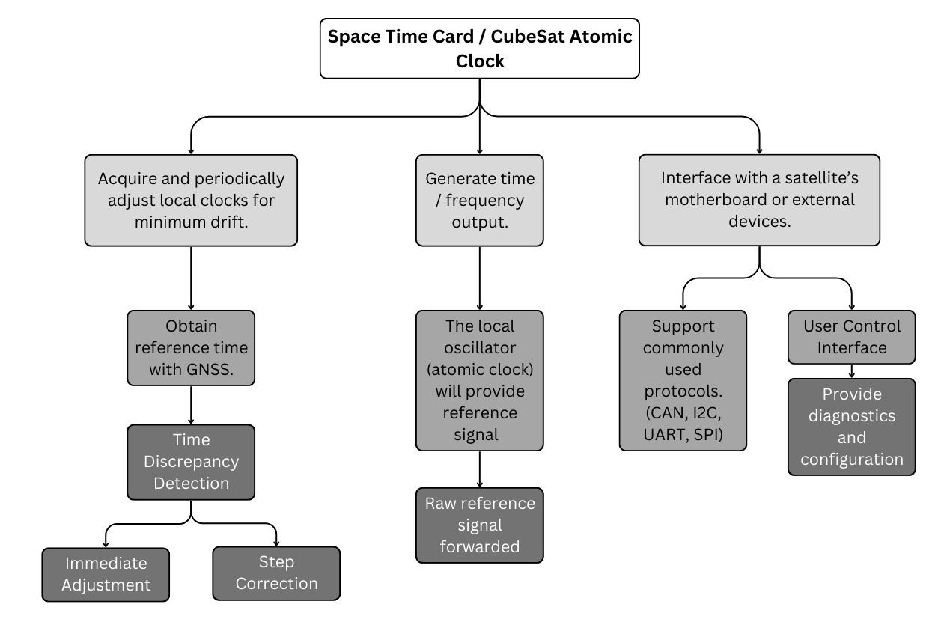
Functional Tree:
Notes:
Tanner

Slide 11
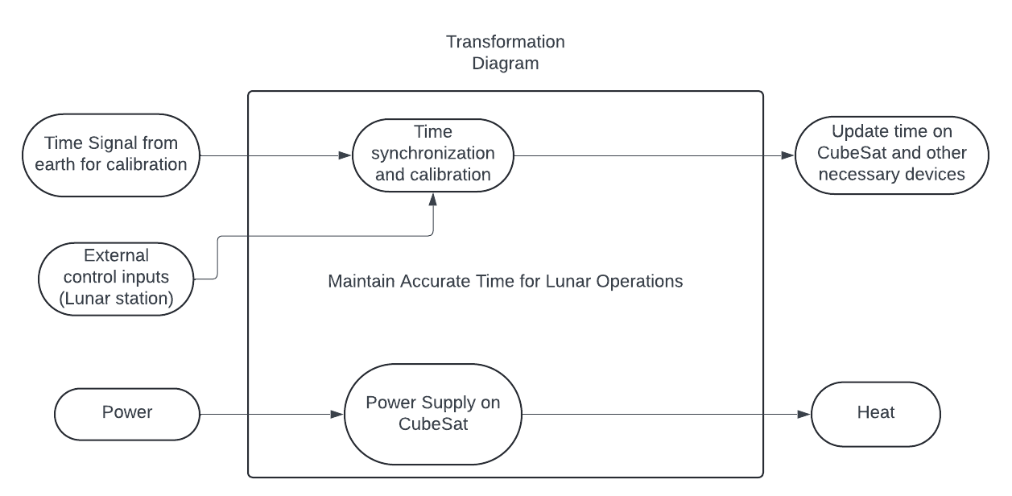
Transformation Diagram:
Notes:
Tanner / Nsadhu

Slide 12
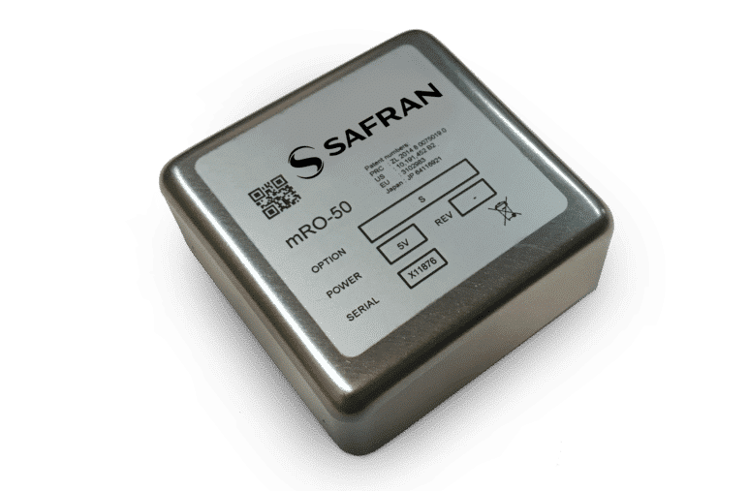
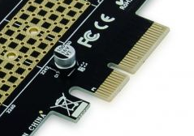

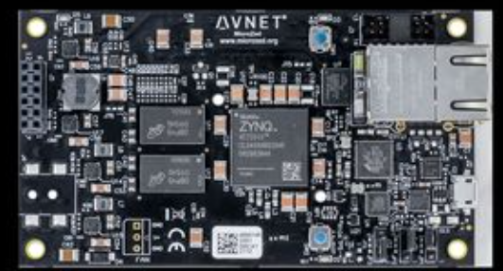
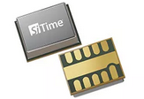
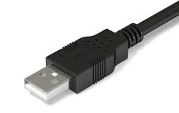
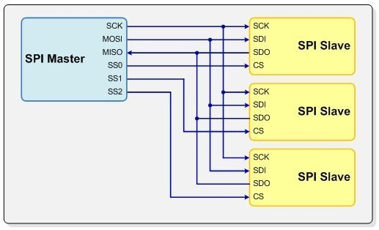
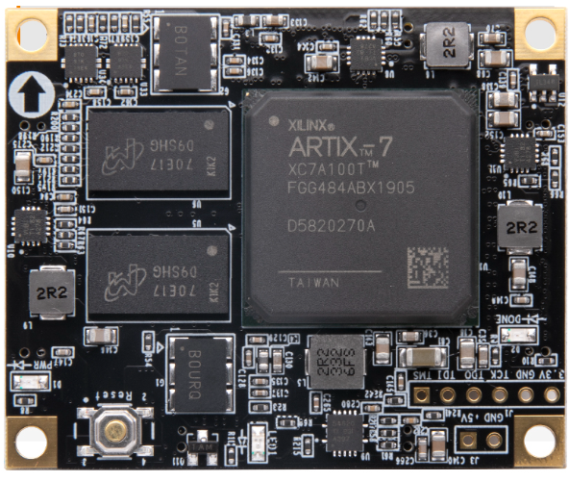
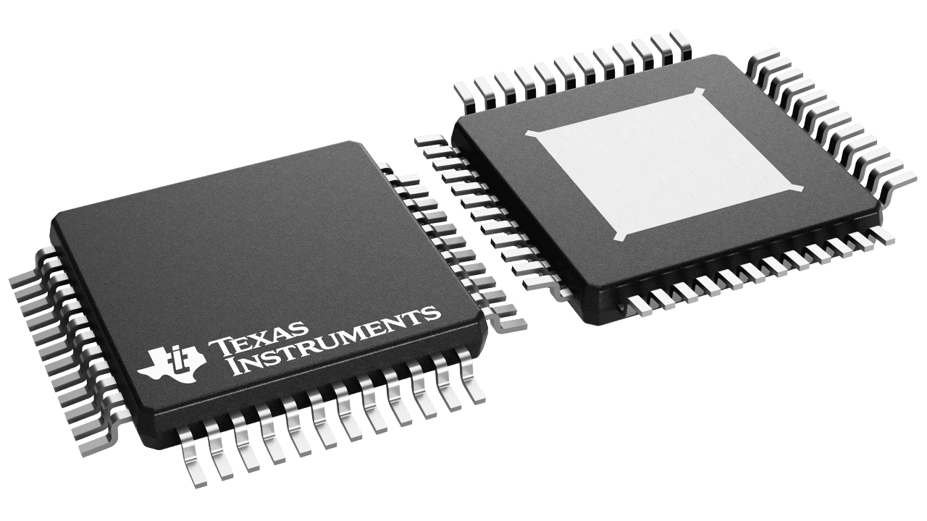
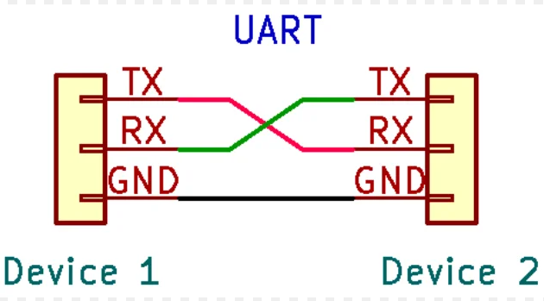
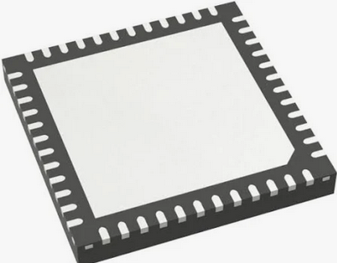
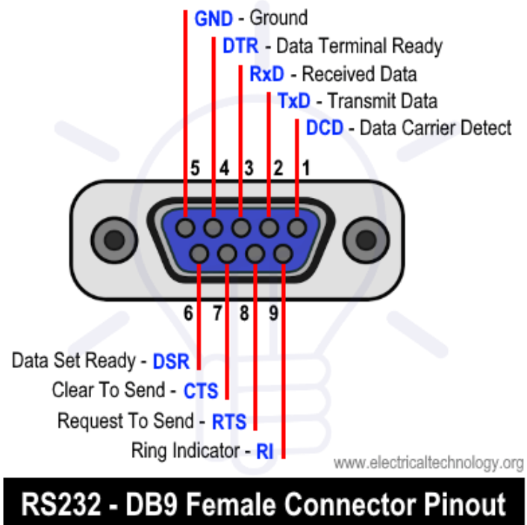
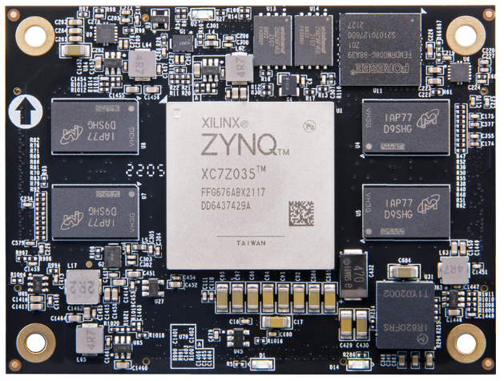
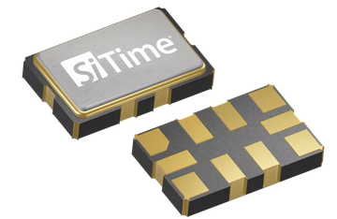

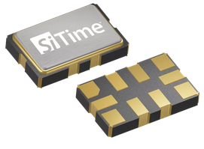
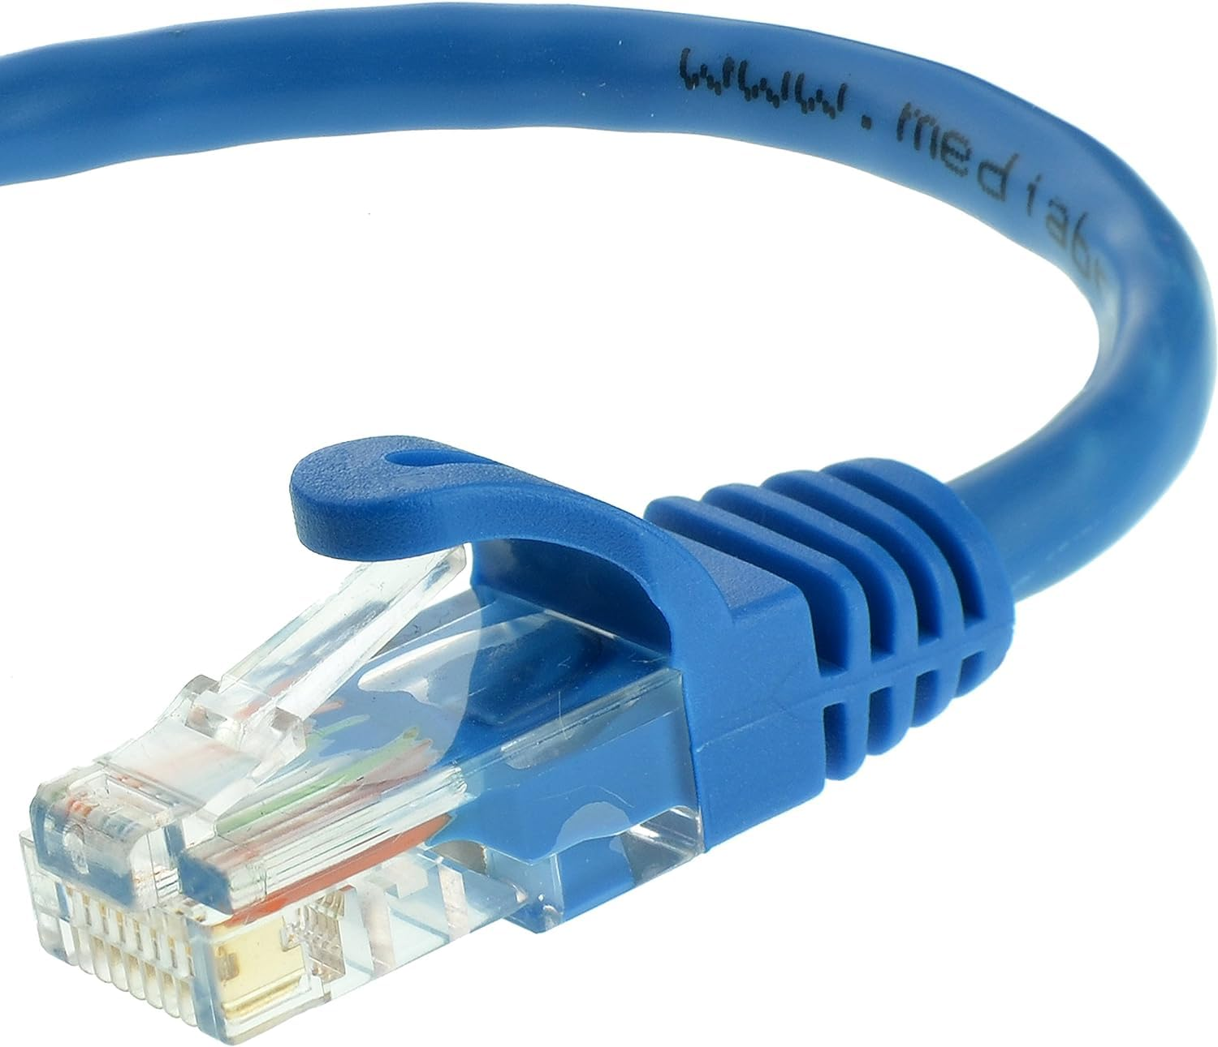
Morphological
Chart
Method of Timekeeping | Method of Communication | Communication Protocol | Programmable Logic | Processing System
mRO-50 | PCIe | I²C | MicroZed 7Z010 | MicroZed 7Z010
SiT5801 | USB | SPI | AC7100B (Just FPGA) | MSP430FR5969-SP
SiT5802 | RS232/485 | UART | AC7Z035B (SoC ARM-PS/PLA-FPGA) | STM32WBA52CG
SiT5356 |  | CAN |  | AC7Z035B (SoC ARM-PS/PLA-FPGA)
SiT5346 |  | Ethernet
Notes:
Drew / Luke

Slide 13
Updated Project Overview
Long Term:
Create a fully functional precision clock time card.
Timekeeping drift of less than 30 nanoseconds.
Compatible with existing space craft motherboards and external devices.
Develop GNSS communication.
Develop a testbench to test clock and communication functionality.
Short Term:
Select materials/development kits for prototype development.
Develop initial BOM (Bill of Materials).
Begin development of initial prototype.
Review previously identified risks/concepts.
Methods of Communication: Slack, Text, Email
Notes:
Eva

Slide 14
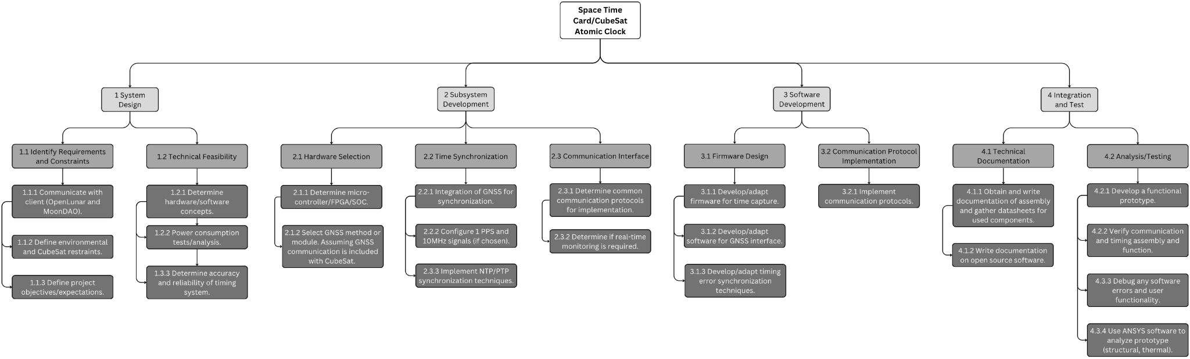
Work Breakdown Structure
Work Breakdown Structure
Notes:
Tanner / Eva

Slide 15
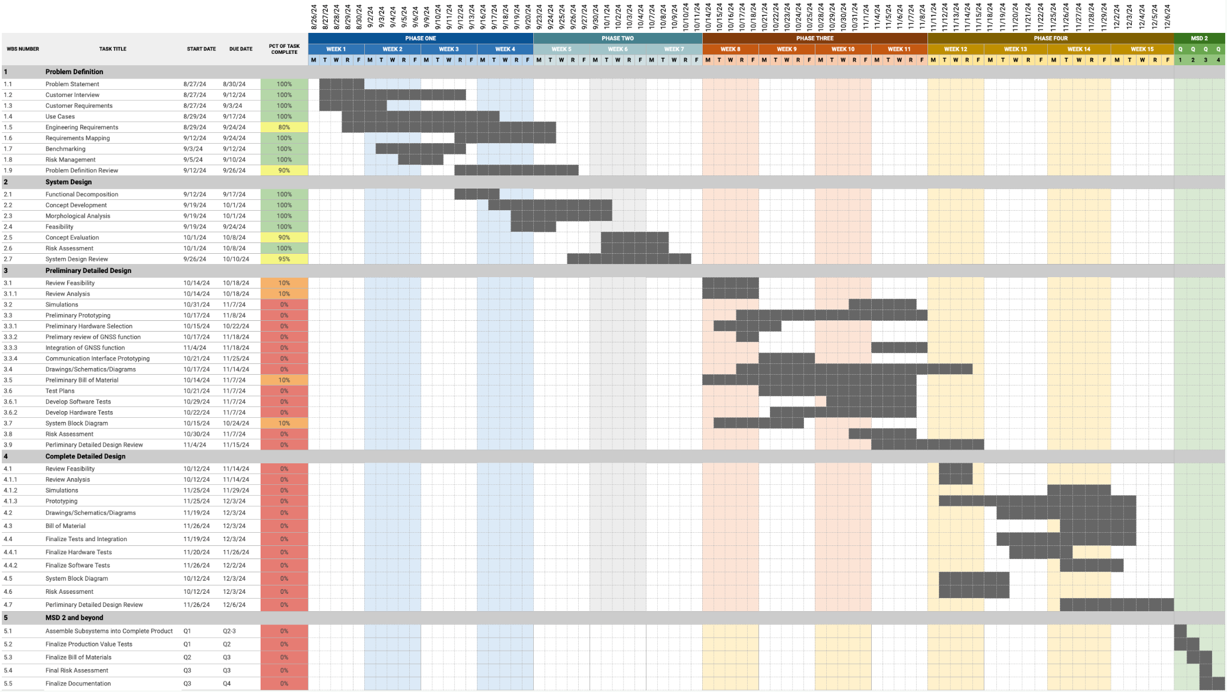
Gantt Chart
Gantt Chart
Notes:
Tanner / Eva

Slide 16
Feasibility
Form of communication between the timecard and the 12U CubeSat
PCIe offers a secure connection but we could not find 12U boards that supported it.
USB is simpler to implement but it does not offer a secure connection.
RS232 offers a secure connection and is simple to implement.
Notes:
Nsadhu

Slide 17
Feasibility
Determine whether to use an FPGA and microcontroller or a SOC
Using an FPGA and microcontroller would be more cost effective but poses its challenges.
A SOC would be simpler to work with eliminating some of the challenges of an FPGA and microcontroller but a SOC is more expensive.
Notes:
Nsadhu

Slide 18
Feasibility
Determine whether the timecard will have GNSS
GNSS would be used to communicate with a server but would add to functionality that needs to be implemented.
Excluding GNSS would allow the team to focus on designing a timecard that is good at keeping time so no compromises are made.
Notes:
Nsadhu

Slide 19
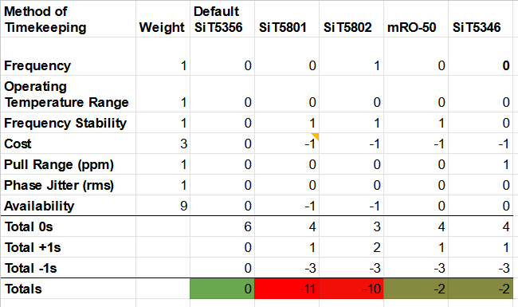
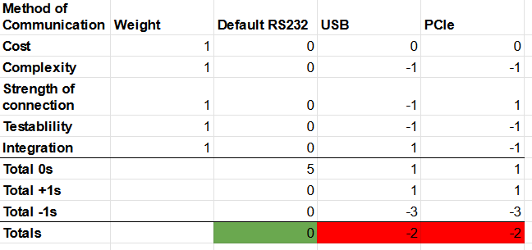
Concept Evaluation & Selection
Notes:
Luke

Slide 20
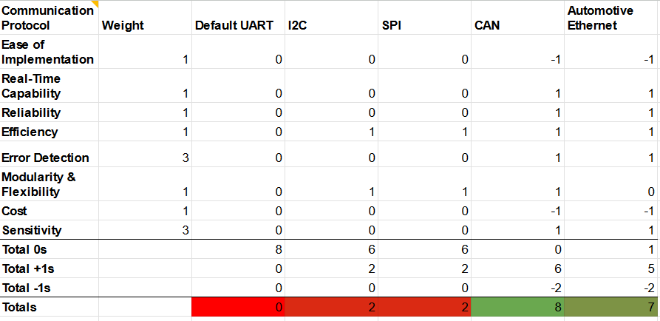
Notes:
Luke

Slide 21
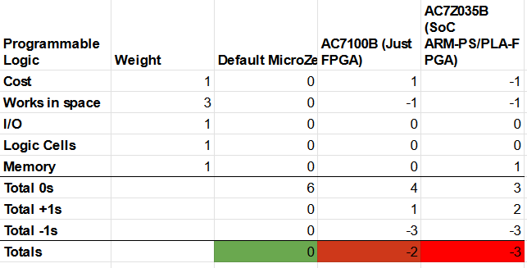
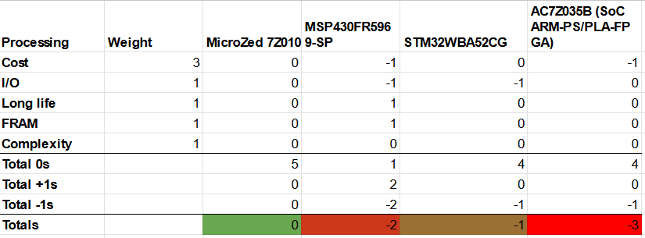

Slide 22
Spec Choices
Method of Timekeeping - SiT5356
Method of Communication - RS232
Communication Protocol - Control Area Network (CAN)
Programmable Logic/Processing - MicroZed 7Z010
Notes:
Luke

Slide 23
SiT5356
High Frequency Stability: It offers a highly stable frequency over a wide temperature range, making it suitable for environments where precise timing is critical.
Low Power Consumption: Designed for low power consumption, it’s ideal for applications where energy efficiency is important.
Ruggedness and Durability: As a MEMS oscillator, it is more resistant to shock, vibration, and other environmental stresses compared to quartz oscillators
Notes:
Luke

Slide 24
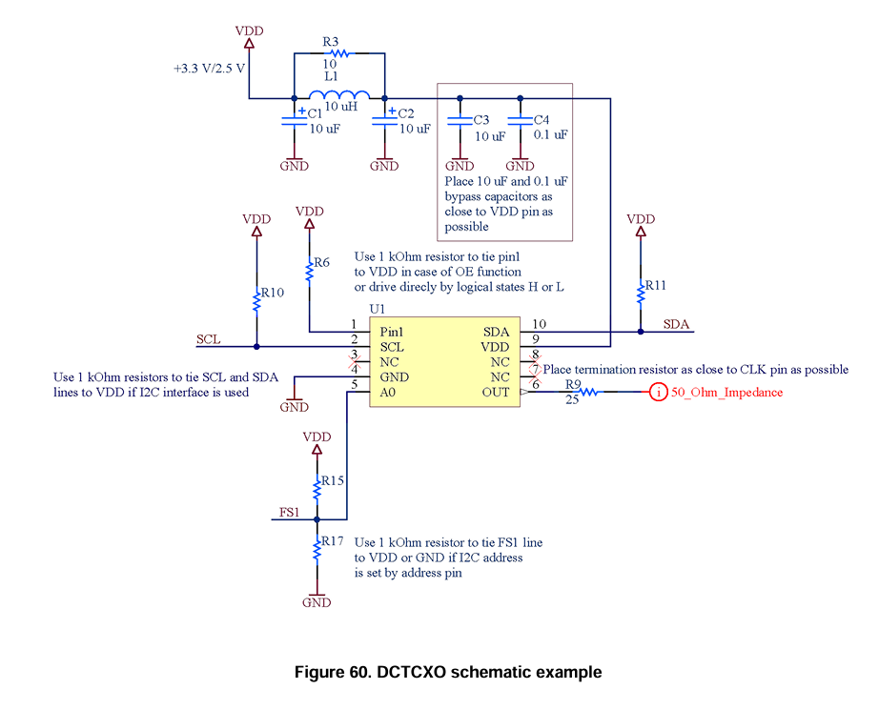
Notes:
Luke

Slide 25
RS232
Asynchronous Communication: RS232 transfers data one bit at a time, without requiring a clock signal for synchronization.
Simple, Robust Protocol: RS232 is known for being simple and robust, making it a reliable choice in industrial and space applications where interference or signal degradation could occur.
Notes:
Luke

Slide 26
CAN
Error Detection and Correction: CAN is known for its strong error-checking mechanisms, which include cyclic redundancy checks (CRC) and acknowledgment (ACK) bits. If an error is detected during transmission, the system can automatically request a retransmission.
High Noise Immunity: CAN is highly immune to electromagnetic interference (EMI), making it well-suited for environments with electrical noise, such as in automotive systems or space applications where reliability is crucial.
Notes:
Luke

Slide 27
MicroZed 7Z010
Zynq-7000 SoC:
Processing System (PS): A dual-core ARM Cortex-A9 processor, which can run a full operating system like Linux, or a real-time operating system (RTOS) for software-based tasks.
Programmable Logic (PL): A traditional FPGA fabric, allowing for custom hardware acceleration, parallel processing, and digital signal processing (DSP) tasks. The 7Z010 variant includes about 28,000 logic cells and 80 DSP slices.
Notes:
Luke

Slide 28
System Architecture
Size, weight, and power characteristics are compatible with 12U CubeSat or smaller
Timekeeping drift less than 30 nanoseconds per earth day
Include an FPGA for custom programmable logic synthesis
Integrated Atomic Clock for timekeeping
Completely Open-Source
Maximum budget constrained to $10k, preference placed on under $5k
Notes:
Luke

Slide 29
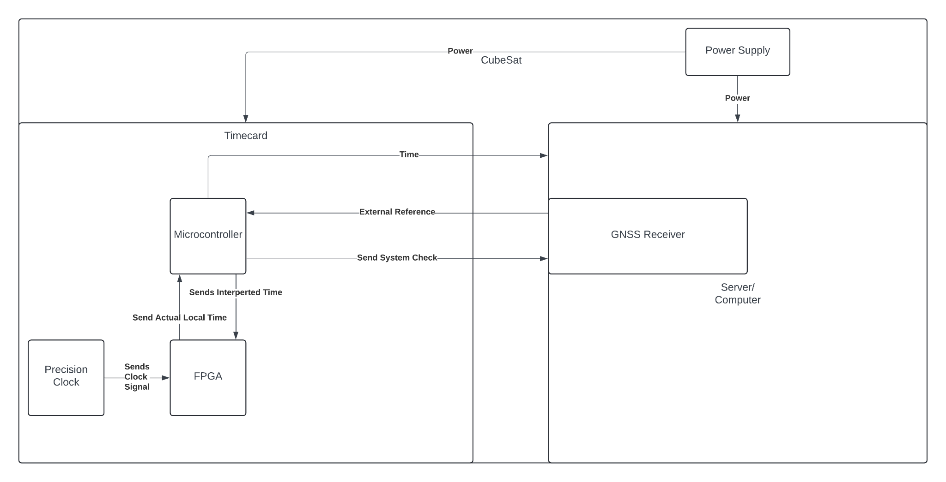
System Architecture:
Notes:
Luke

Slide 30
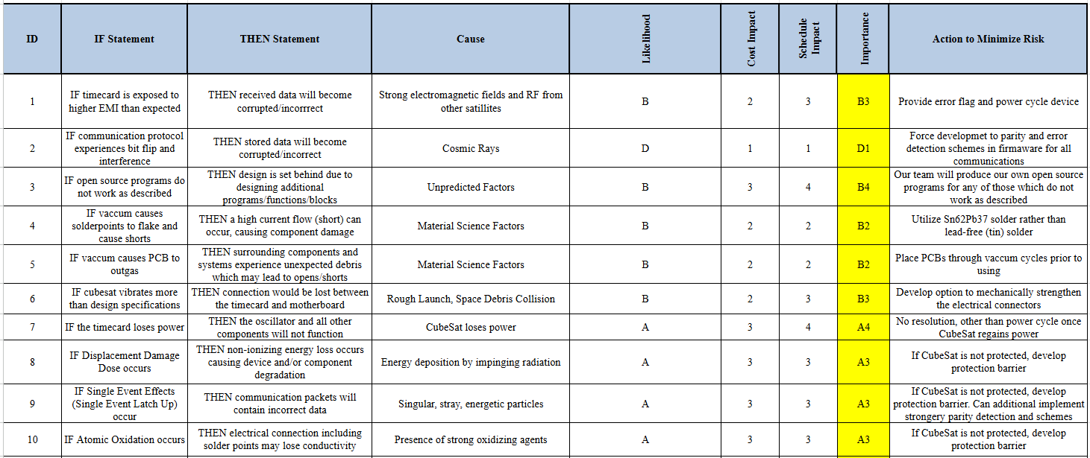
Risk Assessment
Radiation resistance
Temperature Extremes
Vacuum Conditions
Electromagnetic Interference
Notes:
Drew

Slide 31
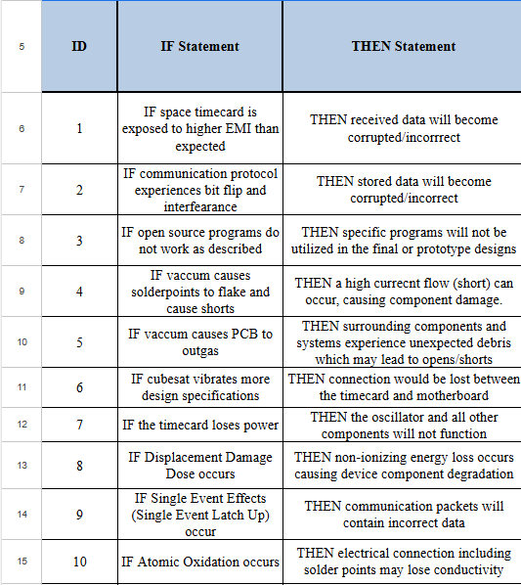
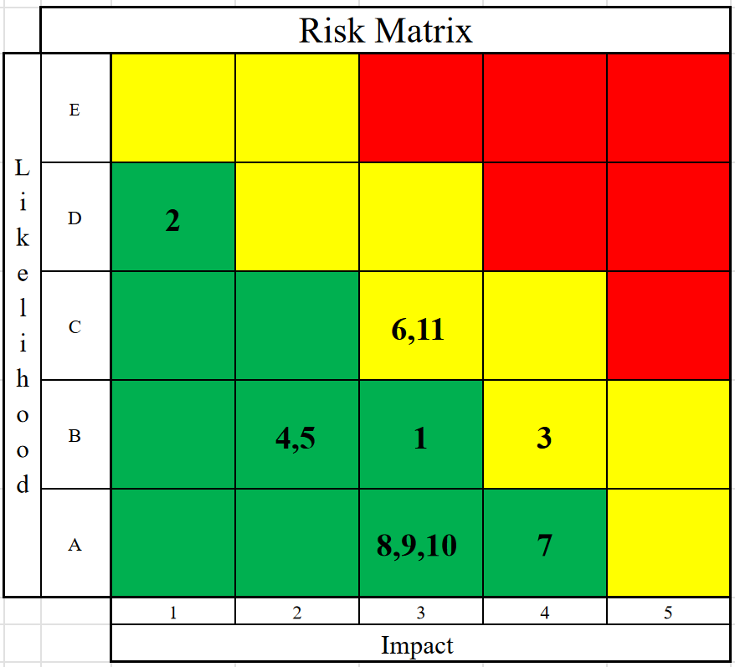
Notes:
Drew

Slide 32
Solution Statement
The end result of this project is a functioning prototype of a derivative Time Card, containing an FPGA. This Time Card will independently maintain accuracy over time with the timekeeping drift not exceeding 30 nanoseconds. The product will be compatible with existing spacecraft systems, including CubeSats and its standards and able to communicate with existing time networks.
Notes:
Eva

Slide 33
Open Items
Obtain details about development equipment from Spex
Contact Safran and Meta about power requirements
Notes:
Ian

Slide 34
Goals for Next Phase
Start the preliminary prototyping process:
Proof of concepts and functionalities developed within previous phase.
Possibly obtain example CubeSat motherboard.
Begin prototyping time-card:
Development of BOM, development kits, and testbenches.
Furnish risks and feedback from current phase review.
Personal Goals can be furnished upon request.
Notes:
Tanner

